Slide 1
Physics-Informed Machine Learning for Modeling and Control of Dynamical Systems
Authors: Truong X. Nghiem, Jan Drgona, Colin Jones, Zoltan Nagy, Roland Schwan, Biswadip Dey, Ankush Chakrabarty, Stefano Di Cairano, Joel A. Paulson, Andrea Carron, Melanie N. Zeilinger, Wenceslao Shaw Cortez, Draguna L. Vrabie

Slide 2
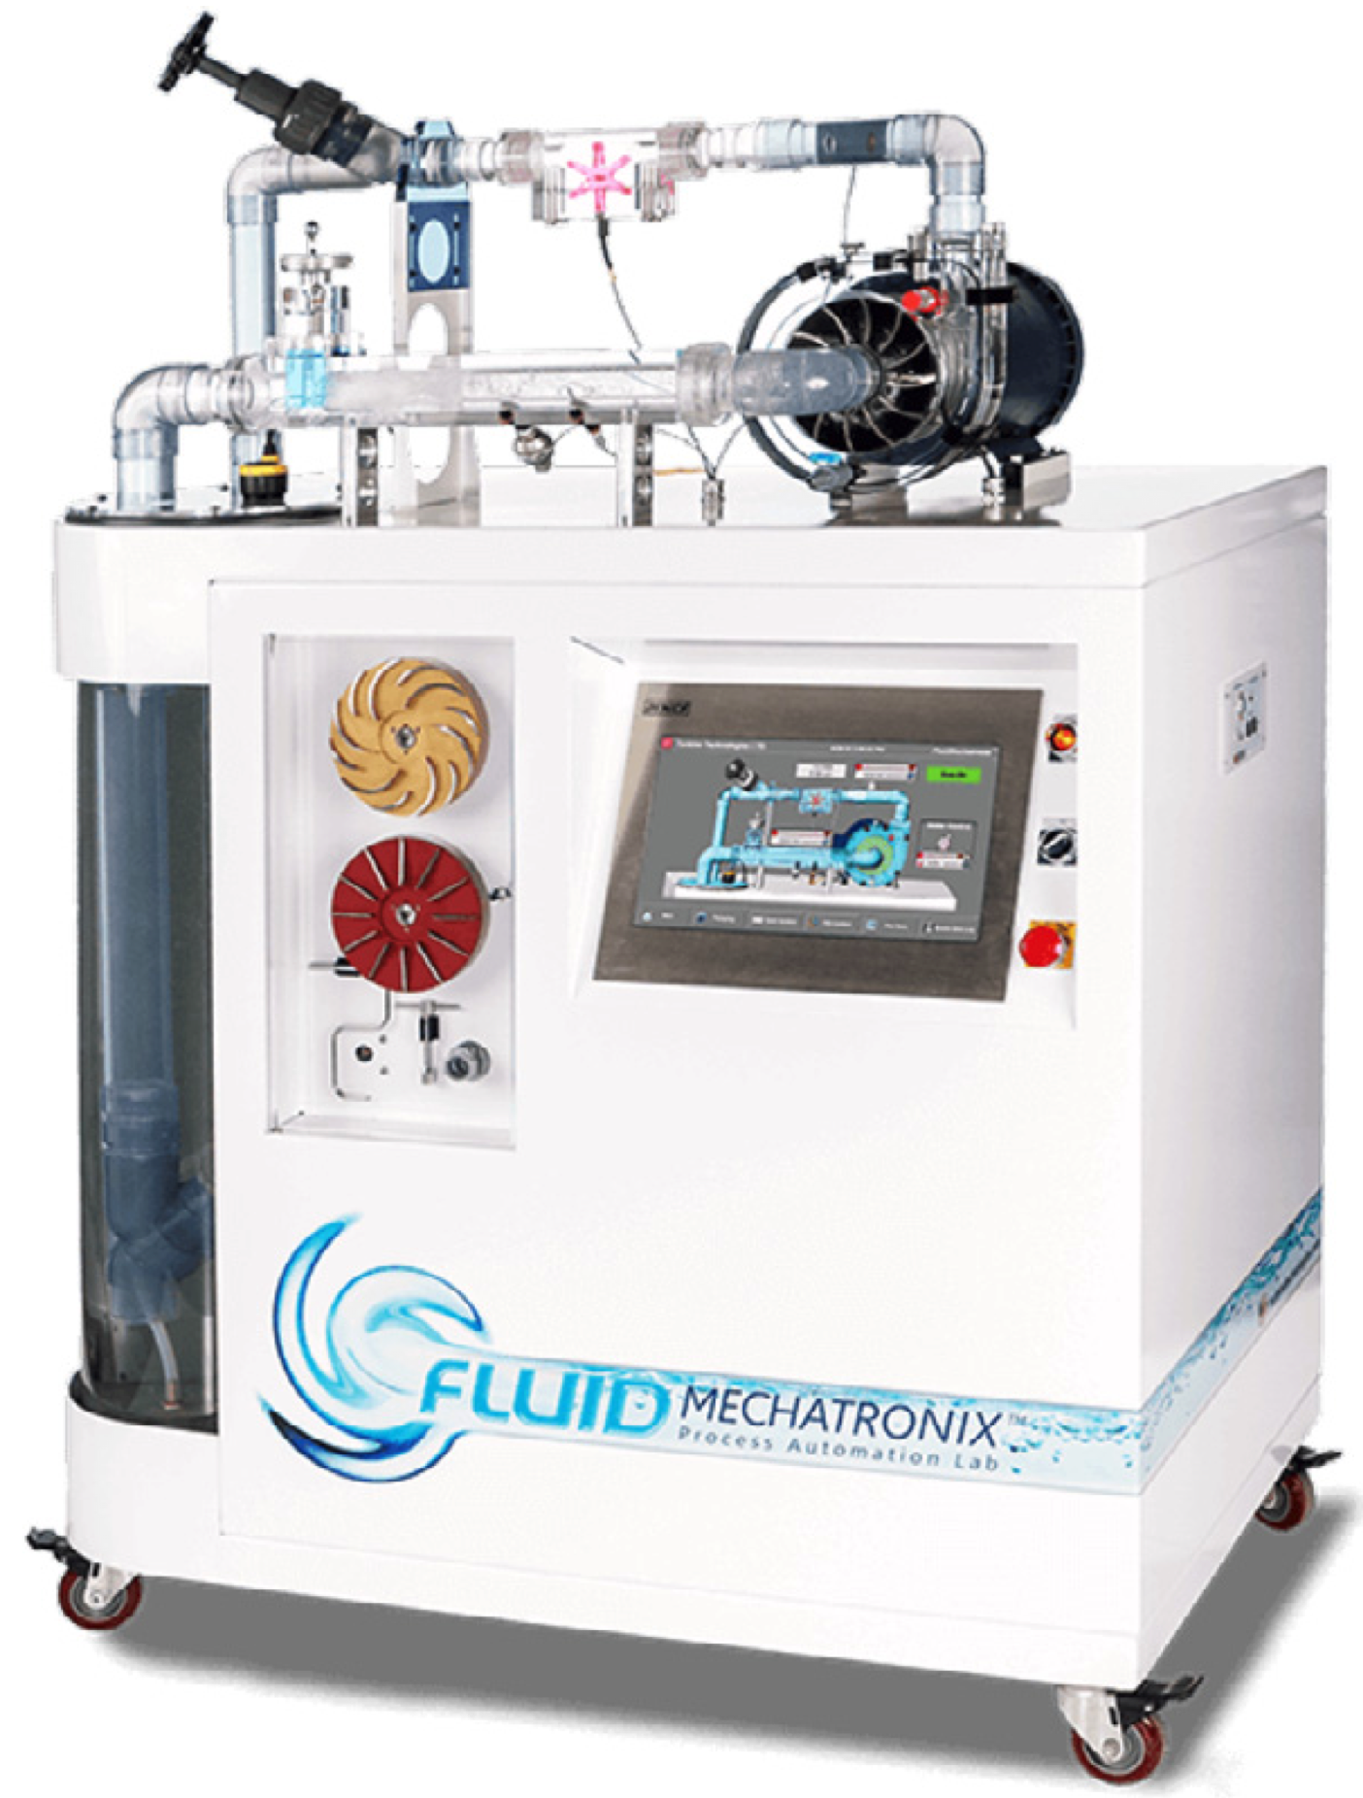
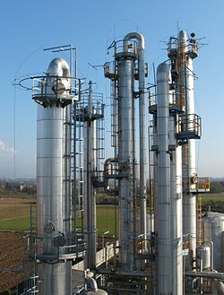

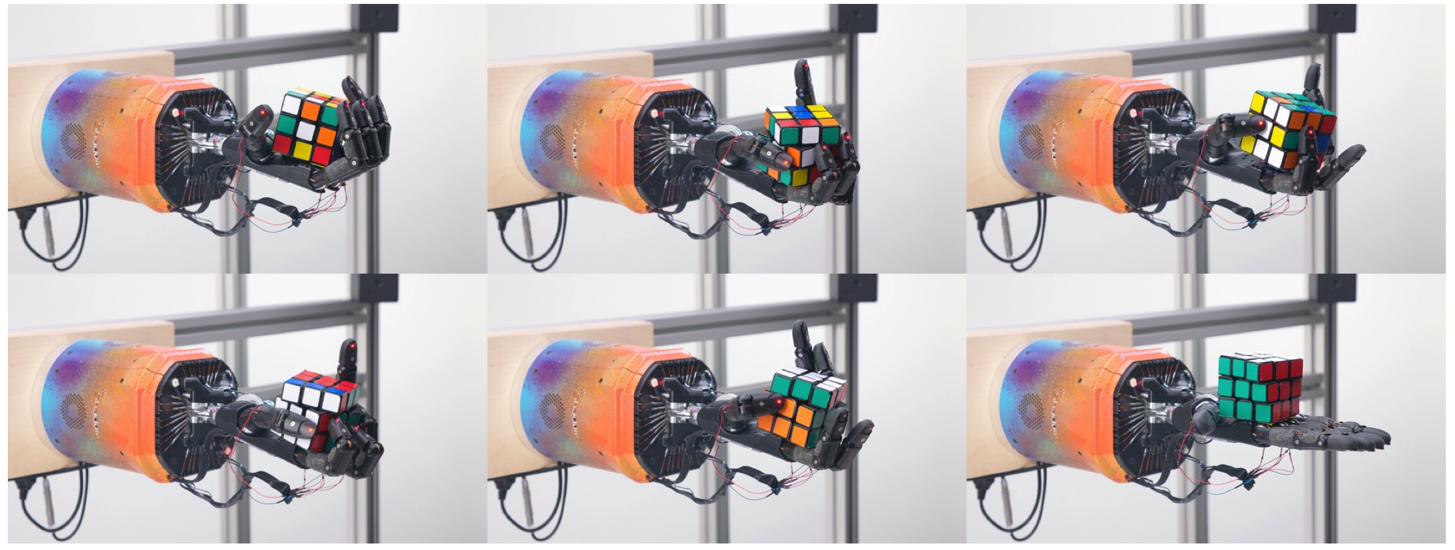
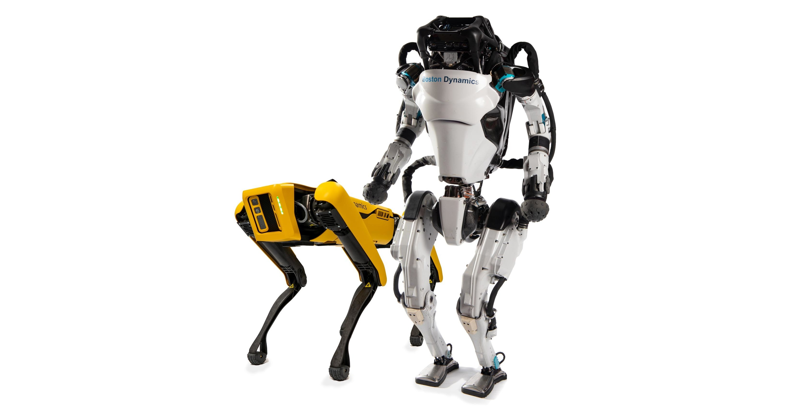
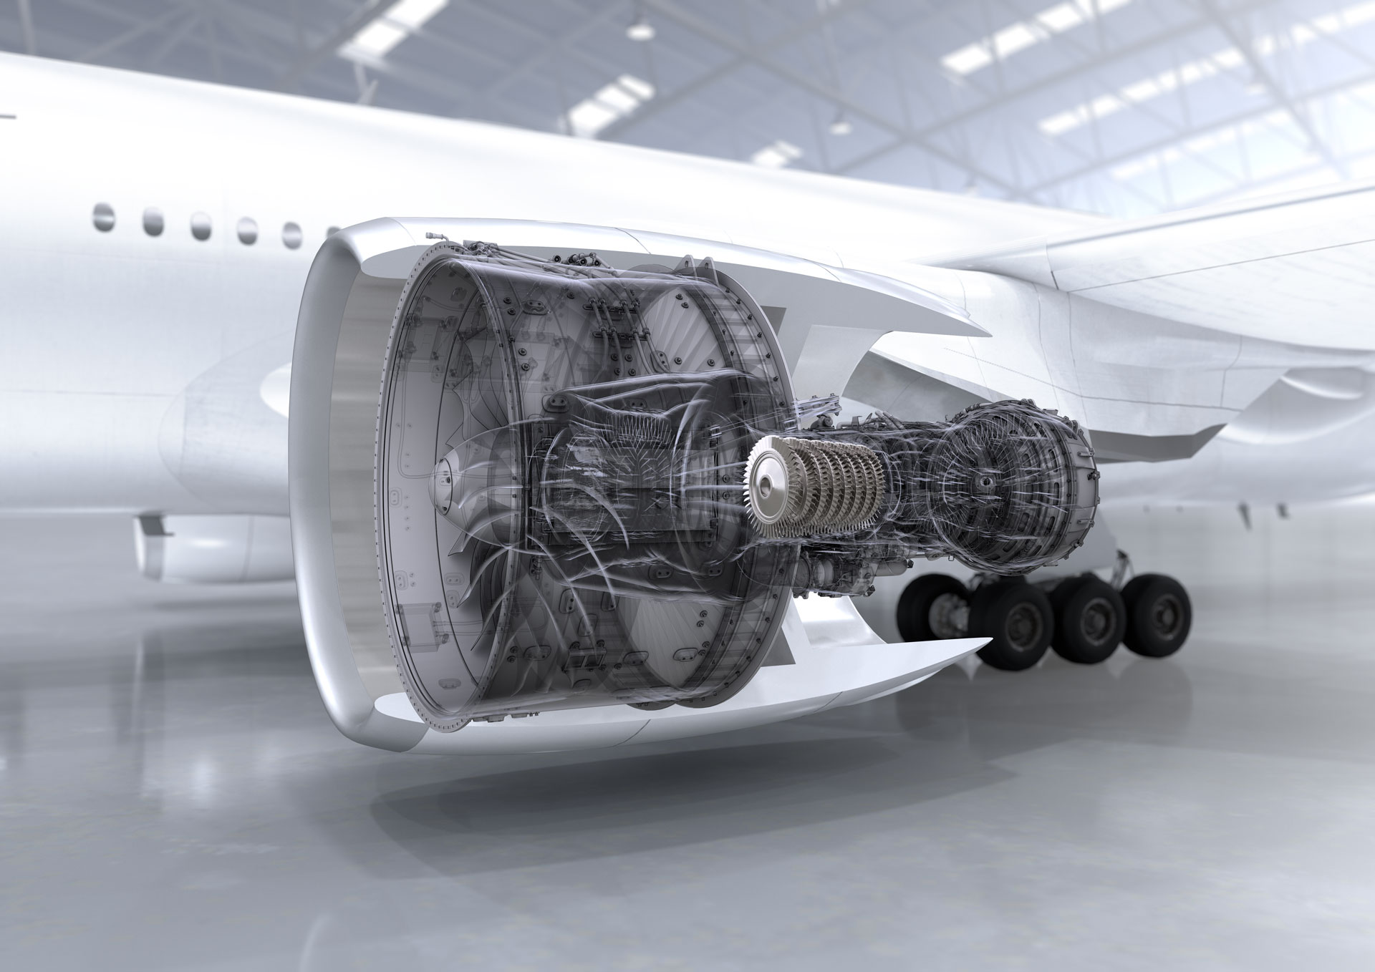
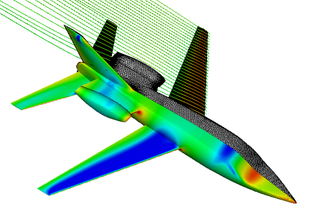
Engineering systems generate large amounts of data
Process Control
Energy Systems
Robotics
Aerospace industry

Slide 3
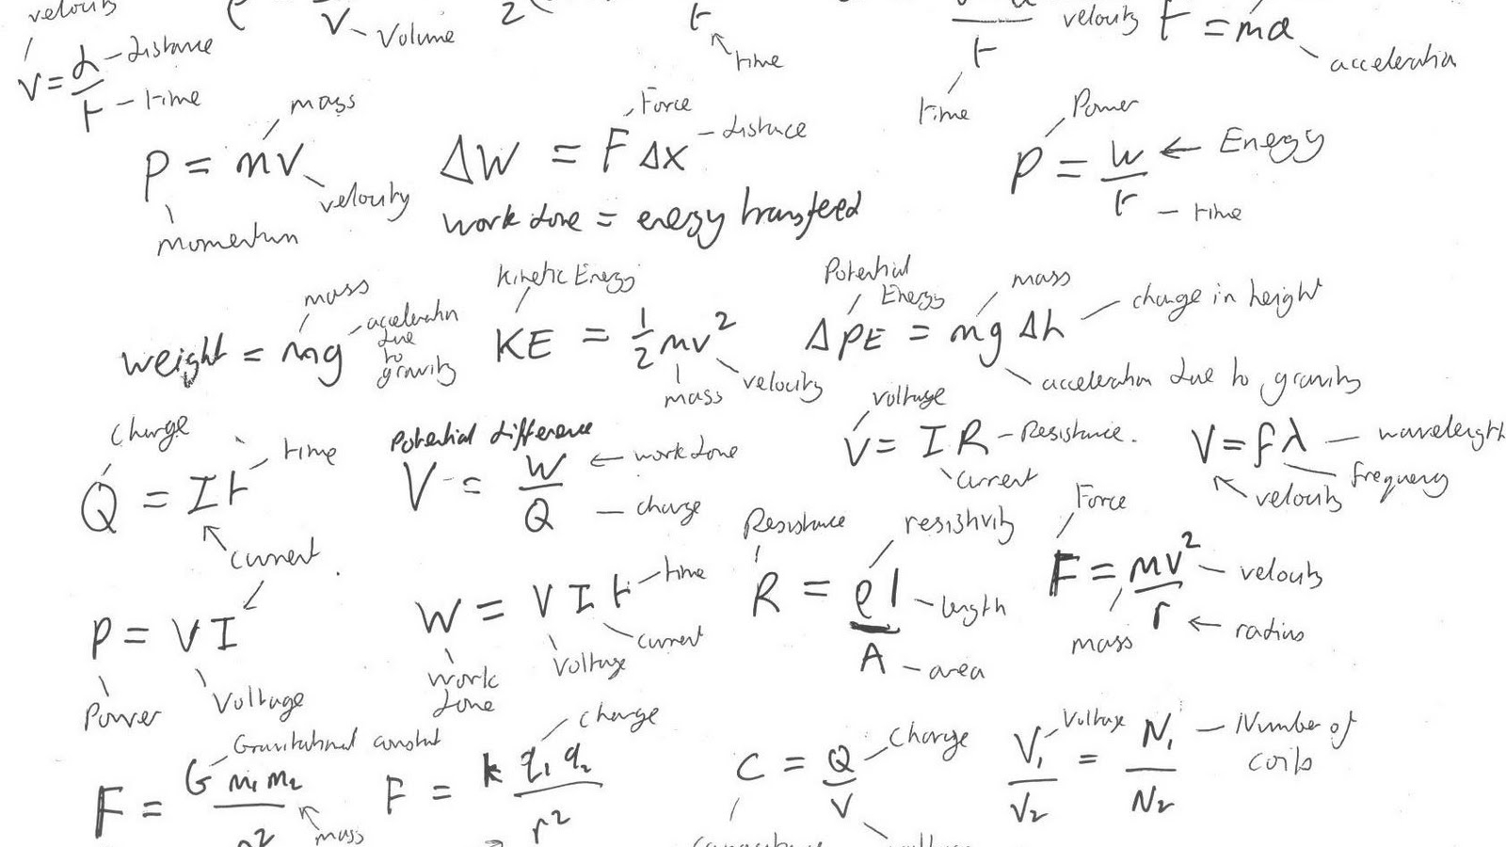
However traditional engineering applications
are governed by fundamental principles
have physical constraints
Examples:
Conservation law,
Laws of motion
Ranges of constants (efficiencies)
Physical constants (gravity)

Slide 4
ML methods cannot satisfy fundamental principles and underlying physics
Significant limitation to real-world deployment

Slide 5
If we could integrate Physics into ML …
Reduced data requirements for ML
Higher precision & improved generalization
Increased interpretability & trust

Slide 6
If we could integrate Physics into ML …
Reduced data requirements for ML
Higher precision & improved generalization
Increased interpretability & trust
This tutorial ☺
Physics
Informed
Machine
Learning
Also called:
Scientific machine learning (SciML)
Physics-constrained machine learning
Domain-aware machine learning
Knowledge-based machine learning

Slide 7
Definition: Physics Informed Machine Learning
PIML is a set of methods and tools that systematically integrate machine learning algorithms with mathematical models developed in various scientific and engineering domains.
… enforcing constraints such as symmetries, causal relationships, or conservation laws, or abstract properties such as stability, convexity, or invariance ...

Slide 8
PIML for Control of Dynamical Systems
PIML for System Identification
PIML for Control
Analysis and Verification of ML models
PIML for Digital Twins
Conclusions | Challenges | Opportunities

Slide 9
Physics-Informed Machine Learning for System Identification
Jan Drgona

Slide 10
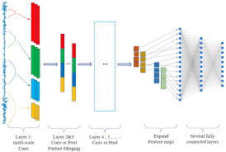
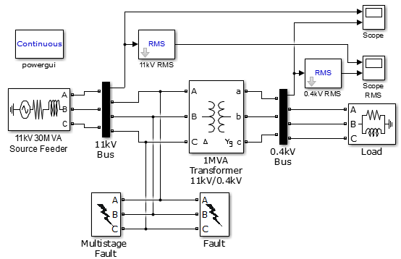
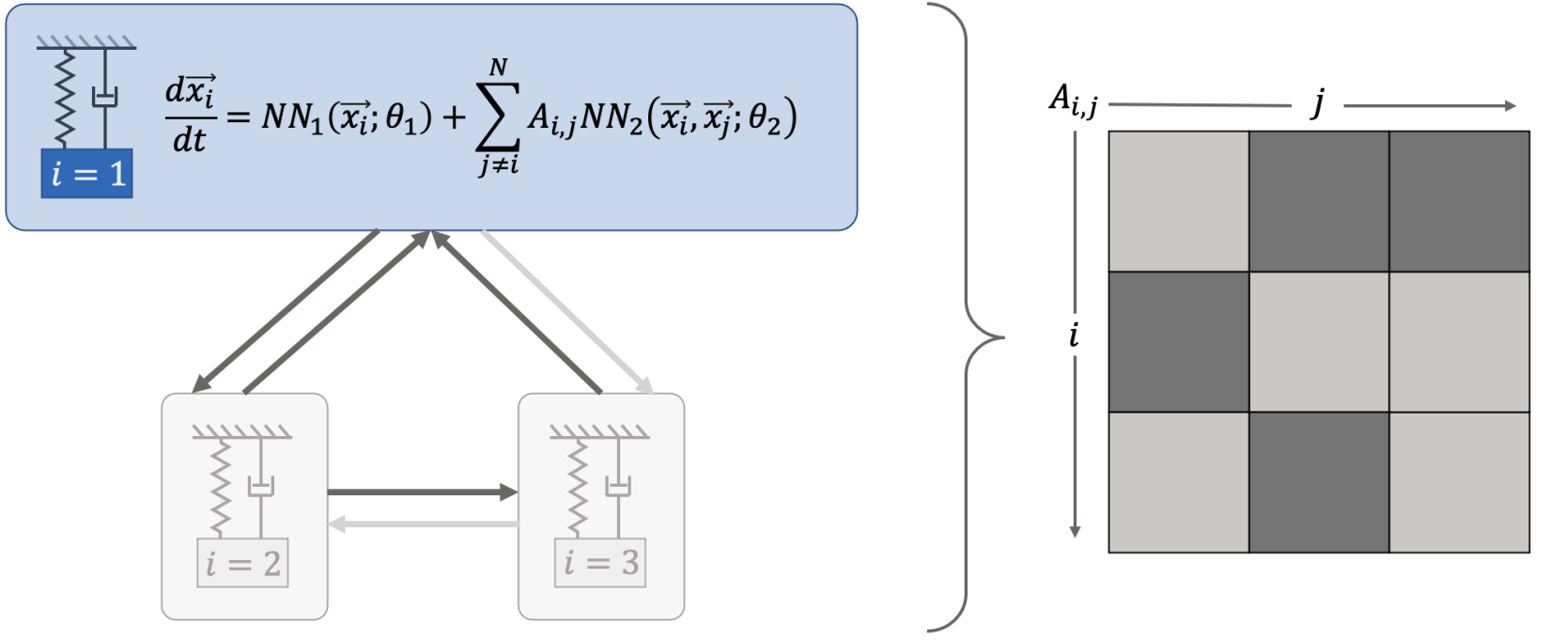

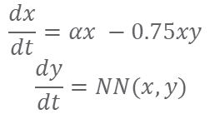
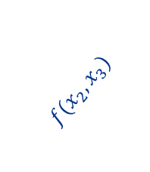
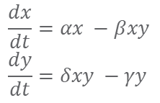
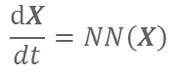
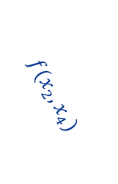
Landscape of Dynamical Systems Modeling Approaches
White-box
Gray-box
Black Box
$$\frac{dx}{dt}=αx −βxy$$
$$\frac{dy}{dt}=δxy −γy$$
$$\frac{dx}{dt}=αx −0.75xy$$
$$\frac{dy}{dt}=NN(x,y)$$
Models
$$\frac{dX}{dt}=NN\left(X\right)$$
More domain knowledge
Less domain knowledge
physics-based
networked neural ODEs
neural differential equations
state space models
physics priors
graph neural networks
3
$$f(x_{2},x_{3})$$
$$f(x_{2},x_{1})$$
1
2
$$f(x_{2},x_{4})$$
4

Slide 11
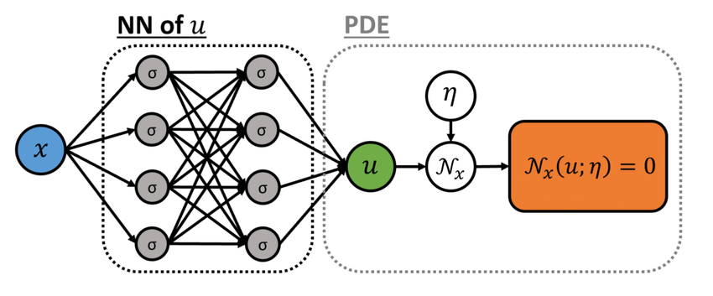
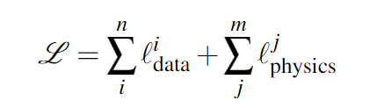
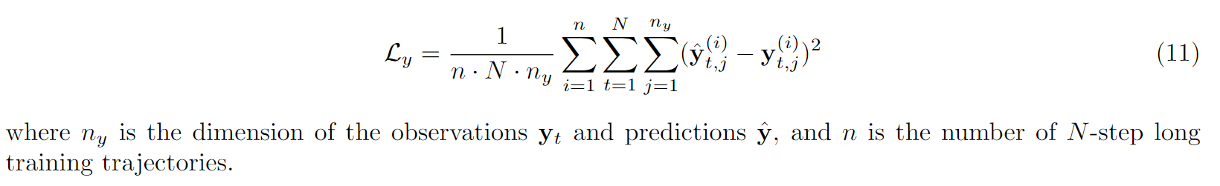
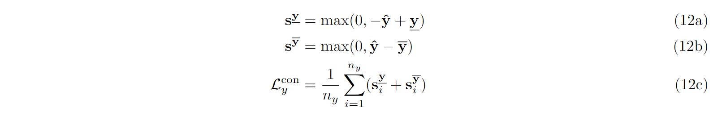
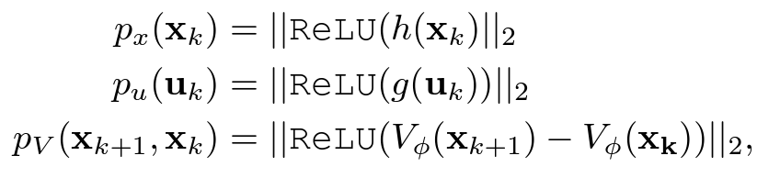
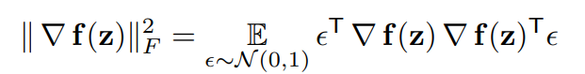
PIML Loss Functions
Dataset: time series of inputs and outputs
PIML loss
PIML Loss:
Loss Terms:
Tracking
State constraints penalties
Lyapunov condition penalties
Jacobian regularizations
M. Raissi, et al., Physics-informed neural networks: A deep learning framework for solving forward and inverse problems involving nonlinear partial differential equations, 2019

Slide 12
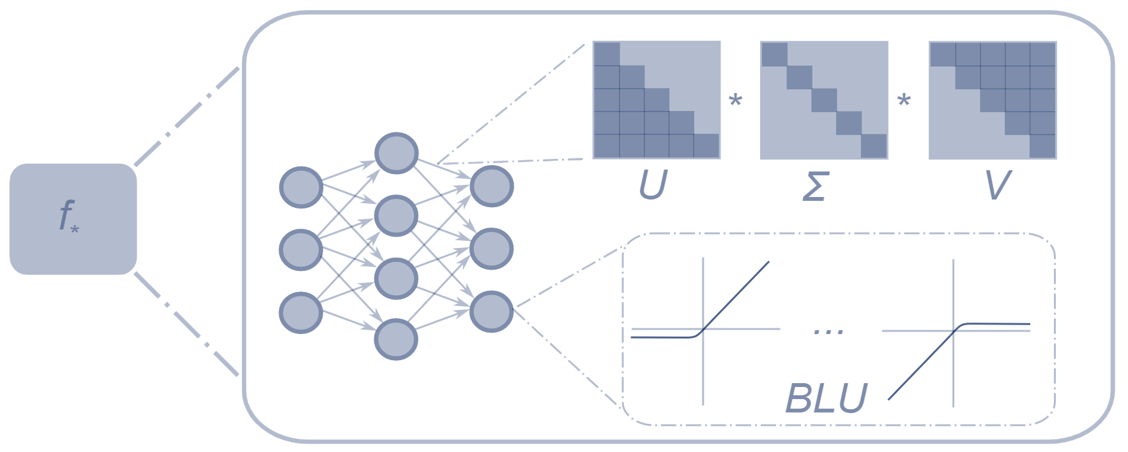
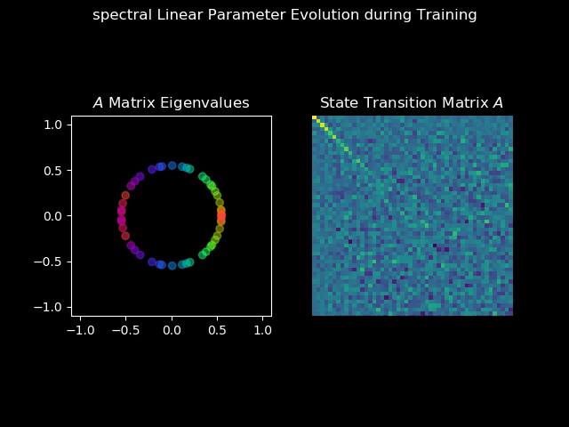
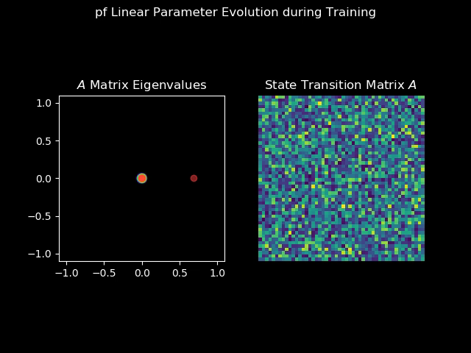
Matrix Factorizations for PIML Models
Can be used to enforce sparsity, spectral conditions, or other linear algebra properties:
Perron-Frobenius Tuor et al., 2020
SVD Spectral Zhang et al., 2018
Orthogonal Mhammedi et al., 2017
Symplectic Haber et al., 2017
Anti-symmetric Chang et al., 2019
Schur Decomposition Kerg et al., 2019
Spectral map
Perron-Frobenius map
https://github.com/pnnl/slim

Slide 13
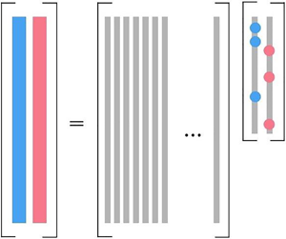
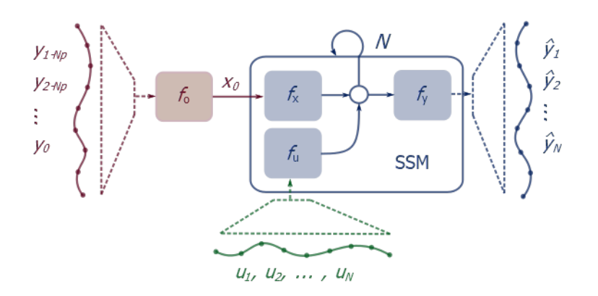
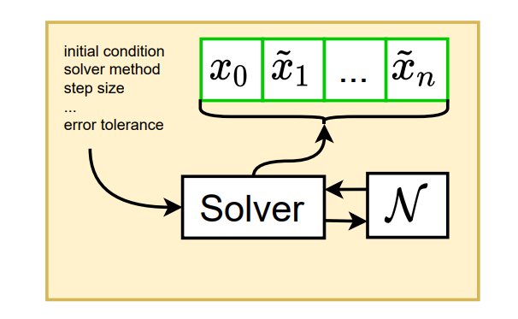
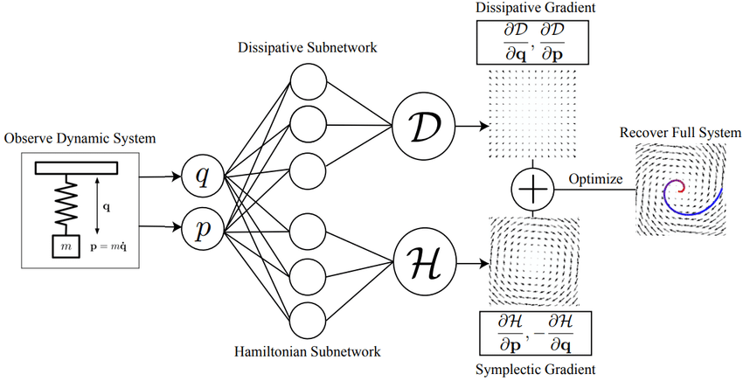
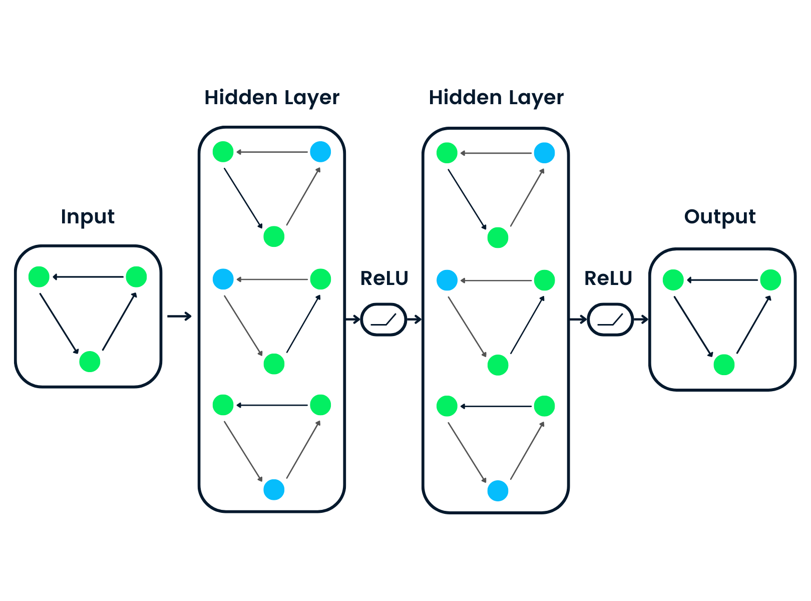
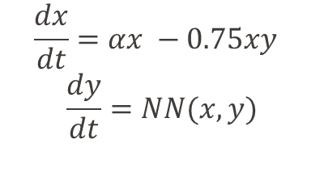
Structural Priors in Data-driven Models
PIML Methods for Learning Nonlinear Dynamics:
Sparse identification of nonlinear dynamics (SYNDy) Brunton et al., 2016
Neural State Space Models (NSSM) Skomski et al., 2021
Graph Neural Networks (GNN) Scarselli et al., 2004
Neural Ordinary Differential Equations (NODE) RTQ Chen et al., 2018
Universal Differential Equations (UDE) Rackauckas et al., 2020
Hamiltonian Neural Networks (HNN) Greydanus et al., 2019
SYNDy
NSSM
NODE
$$\frac{dx}{dt}=αx −0.75xy$$
$$\frac{dy}{dt}=NN(x,y)$$
UDE
HNN
GNN

Slide 14

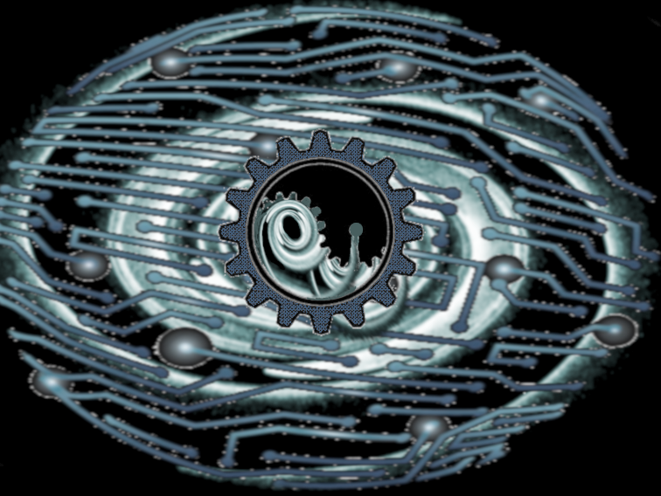

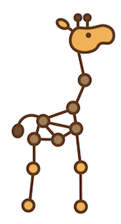

Open-Source PIML Tools for Modeling Dynamical Systems
Julia SciML: Open-Source Software for Scientific Machine Learning https://sciml.ai/
Neuromancer - PyTorch library for physics-informed system identification and control https://github.com/pnnl/neuromancer
Torchdyn - PyTorch library for neural differential equations https://github.com/DiffEqML/torchdyn
Jraph - JAX library for graph neural networks https://github.com/deepmind/jraph
Pytorch Geometric - PyTorch library for graph neural networks https://github.com/pyg-team/pytorch_geometric
PySINDy is a sparse regression package for the SINDy method https://github.com/dynamicslab/pysindy

Slide 15
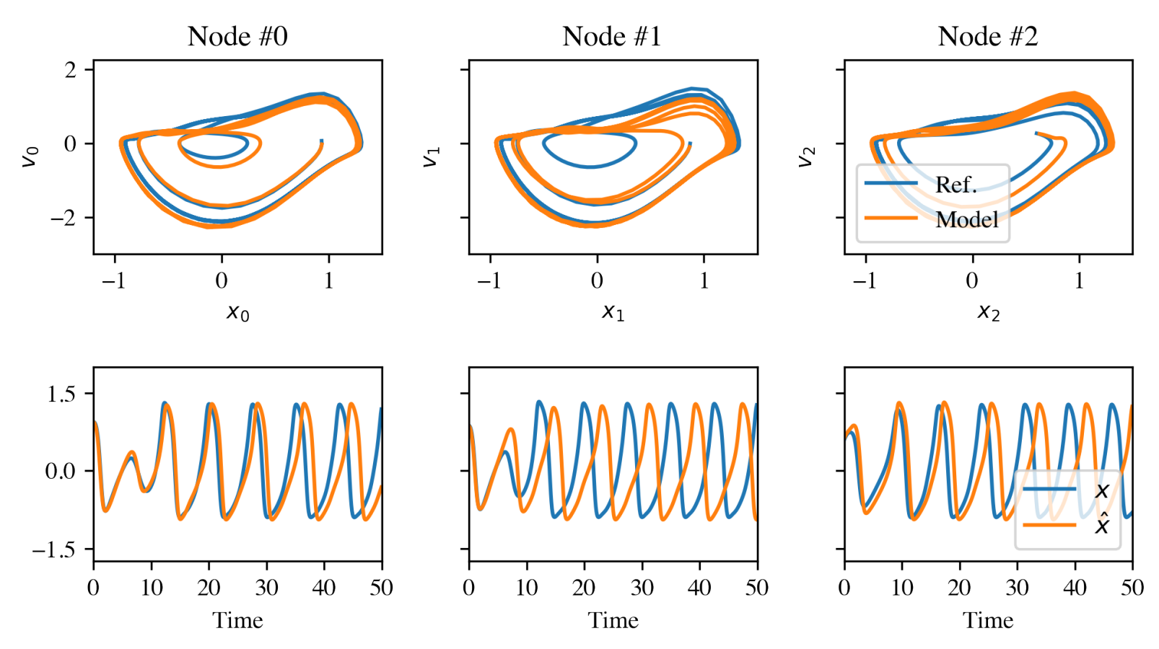
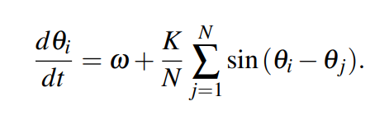
Case Study: Networked Dynamical Systems via Universal Differential Equations
Network of unknown oscillators
Coupling adjacency
Generalization of learned dynamics on never-seen network topology.
Ground truth Kuramoto system:
J. Koch, Z. Chen, A. Tuor, J. Drgona, D. Vrabie; Structural inference of networked dynamical systems with universal differential equations. Chaos, 1 February 2023; 33 (2): 023103.

Slide 16
Physics-Informed Machine Learning for Control
Wenceslao Shaw Cortez

Slide 17
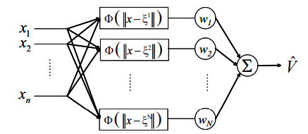
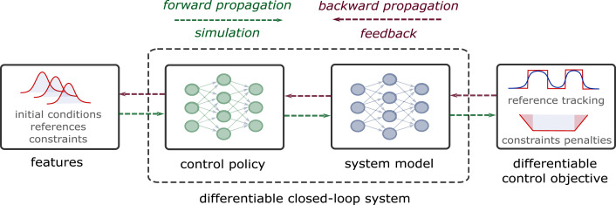
PIML in Control Loop: The Big Picture
Implicit
MPC
Optimization
Plant
Physical priors embedded into data-driven model
PIML model
physical priors
Physical priors embedded into control-oriented functions
Physical priors embedded into control training
Explicit

Slide 18
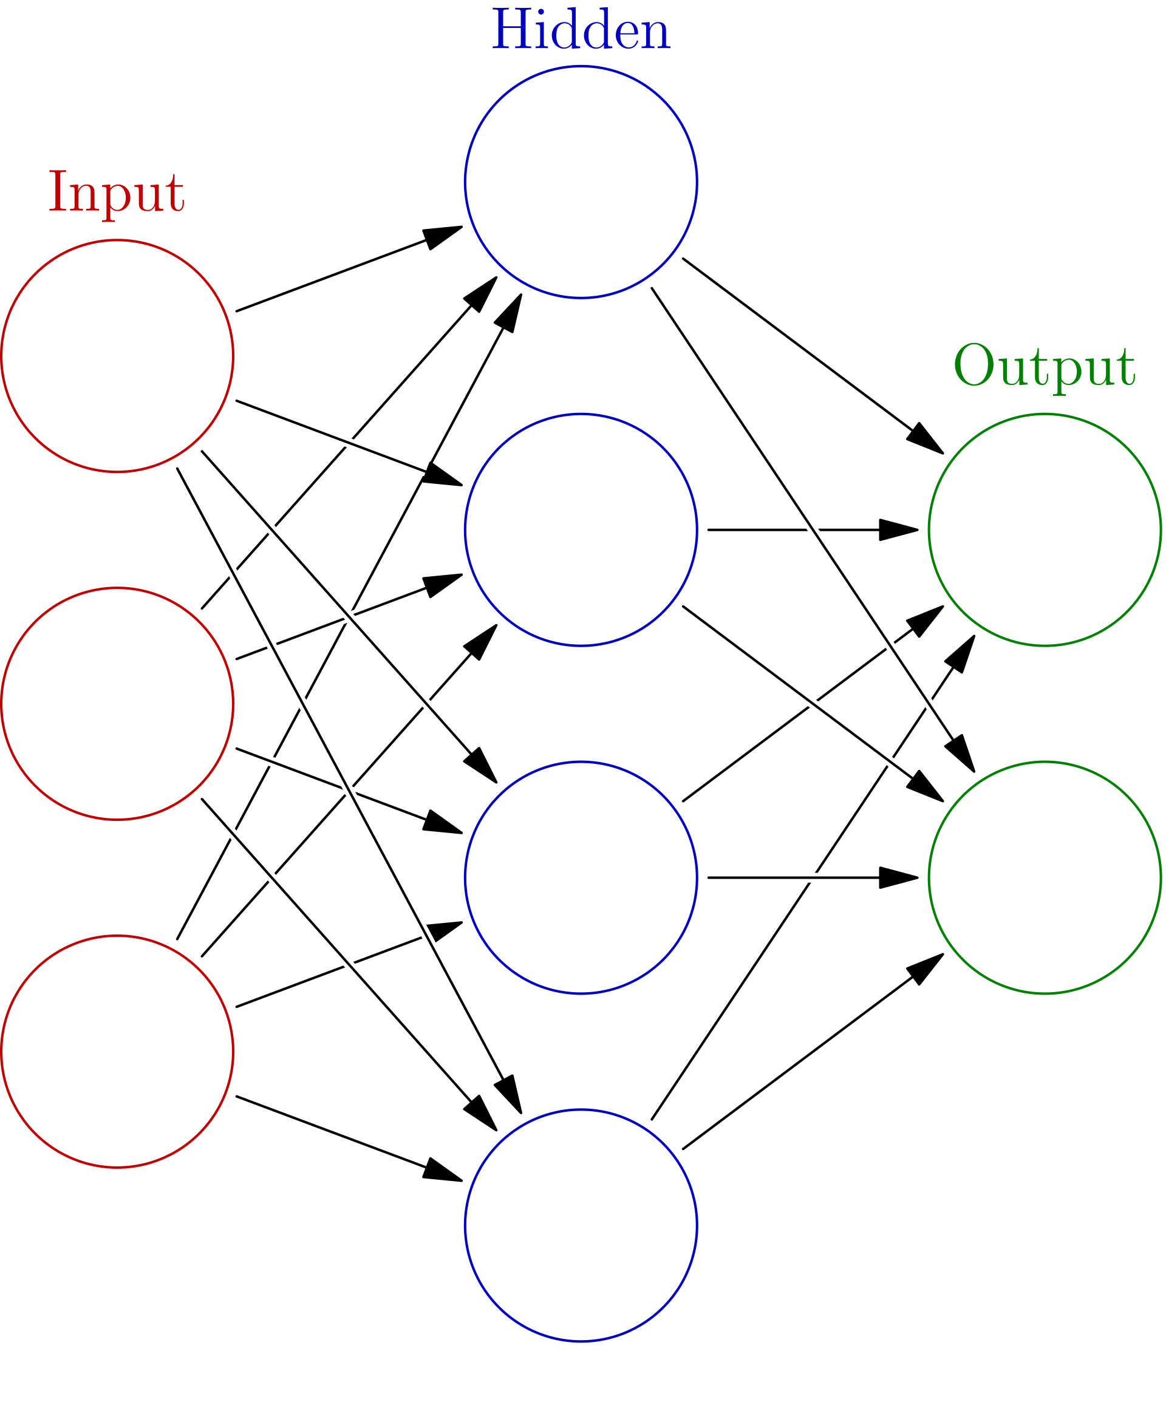
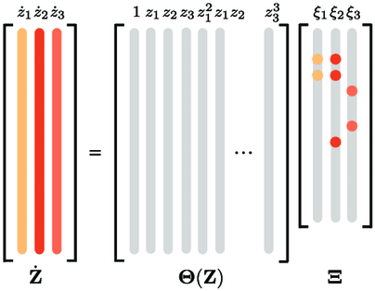
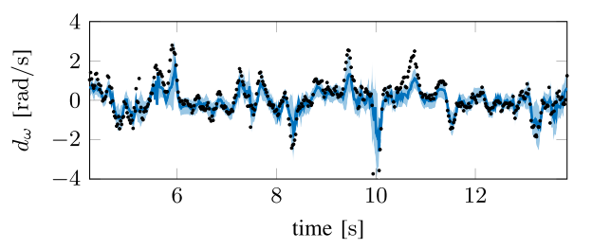
PIML Dynamic Models for MPC
MPC
Optimization
Employ PIML dynamic models in MPC
Leverage physical priors through PIML models
Plant
PIML model
physical priors
What data-driven model to use and how to incorporate it?
Physics-informed
neural networks¹
Sparse identification of nonlinear dynamics (SINDY-MPC)²
Gaussian Process disturbance learning³
MPC
Performance
Constraints
Learned model
Robust model
¹J. Nicodemus, J. Kneifl, J. Fehr, and B. Unger, “Physics-informed Neural Networks-based Model Predictive Control for Multi-link Manipulators,” IFAC-PapersOnLine, vol. 55, no. 20, pp. 331–336, Jan. 2022
²E. Kaiser, J. N. Kutz, and S. L. Brunton, “Sparse identification of nonlinear dynamics for model predictive control in the low-data limit,” Proceedings of the Royal Society A: Mathematical, Physical and Engineering Sciences, vol. 474, no. 2219, p. 20180335, Nov. 2018.
³L. Hewing, J. Kabzan, and M. N. Zeilinger, “Cautious model predictive control using gaussian process regression,” IEEE Transactions on Control Systems Technology, vol. 28, no. 6, pp. 2736–2743, 2020

Slide 19
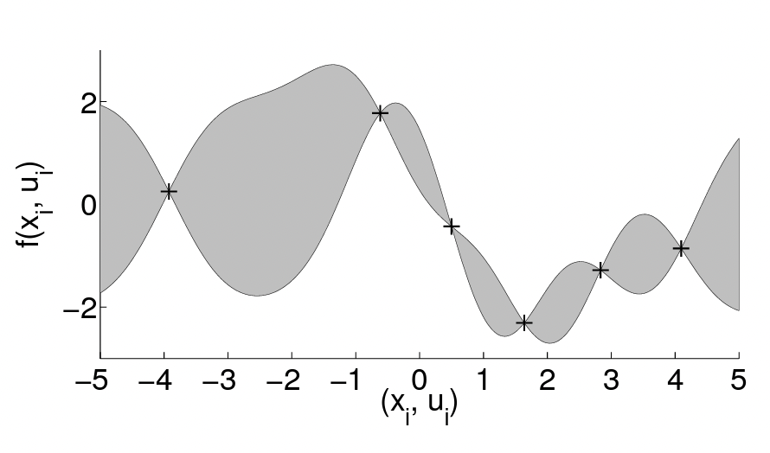
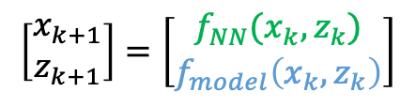
Physics-Informed Reinforcement Learning
PIML model in model-based RL to improve accuracy & physical consistency
Like MPC, physical priors are leveraged through PIML models
RL
Optimization
PIML model
physical priors
GP model reduces RL Training⁴
Physically consistent NN model⁵
MPC-based Value Function⁶
RL
$$\left[\begin{matrix}x_{k+1} \\ z_{k+1}\end{matrix}\right]=\left[\begin{matrix}f_{NN}(x_{k}, z_{k}) \\ f_{model}\left(x_{k}, z_{k}\right)\end{matrix}\right]$$
Optimization
Differentiable MPC
physical priors
⁴M. P. Deisenroth and C. E. Rasmussen, “Pilco: A model-based and data-efficient approach to policy search,” in Proceedings of the 28th International Conference on International Conference on Machine Learning, ser. ICML’11. Madison, 2011, p.465–472.
⁵L. D. Natale, B. Svetozarevic, P. Heer, and C. N. Jones, “Near-optimal Deep Reinforcement Learning Policies from Data for Zone Temperature Control,” in 2022 IEEE 17th International Conference on Control & Automation (ICCA), Jun. 2022, pp. 698–703.
⁶M. Zanon and S. Gros, “Safe Reinforcement Learning Using Robust MPC,” IEEE Transactions on Automatic Control, vol. 66, no. 8, pp. 3638–3652, Aug. 2021.

Slide 20
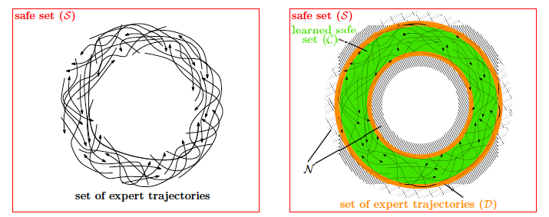
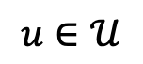
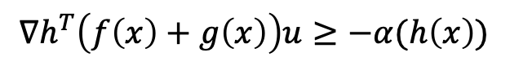
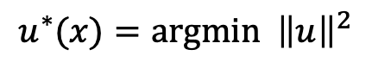
Learning Lyapunov and Barrier functions
Control Lyapunov functions (CLFs): stability
Control barrier functions (CBFs): invariance
How to construct CLF/CBFs?
$$u^{∗}(x)=argmin {\left\|u\right\|}^{2}$$
$$u∈𝒰$$
subject to:
$$∇h^{T}\left(f\left(x\right)+g\left(x\right)\right)u≥−α(h\left(x\right))$$
Learning Stability from Data Samples⁷
Learning Invariance from Experts⁸
⁷T. Tsuzuki, T. Yagi, K. Yoshida, and Y. Yamashita, “A search algorithm for control Lyapunov functions using radial basis function networks,” in SICE Annual Conference 2011, Sep. 2011, pp. 390–394.
⁸A. Robey, H. Hu, L. Lindemann, H. Zhang, D. V. Dimarogonas, S. Tu, and N. Matni, “Learning control barrier functions from expert demonstrations,” in 2020 59th IEEE Conference on Decision and Control (CDC), 2020, pp. 3717–3724.

Slide 21
Differentiable Control
Use automatic differentiation (AD) to train NN-controllers with physics priors
Training motivated by optimal control framework⁹
Physical Priors:
System model, e.g., Lipschitz bounds, Dissipativity
Constraint penalties, e.g., enforcing Lyapunov condition¹⁰, reference tracking, state constraints
⁹J. Drgona, K. Kis, A. Tuor, D. Vrabie, and M. Klauˇco, “Differentiable predictive control: Deep learning alternative to explicit model predictive control for unknown nonlinear systems,” Journal of Process Control, vol. 116, pp. 80–92, 2022.
¹⁰S. Mukherjee, J. Drgoňa, A. Tuor, M. Halappanavar, and D. Vrabie, “Neural Lyapunov Differentiable Predictive Control,” in 2022 IEEE 61st Conference on Decision and Control (CDC), Dec. 2022, pp. 2097–2104.

Slide 22
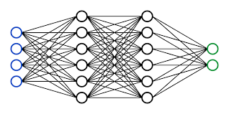
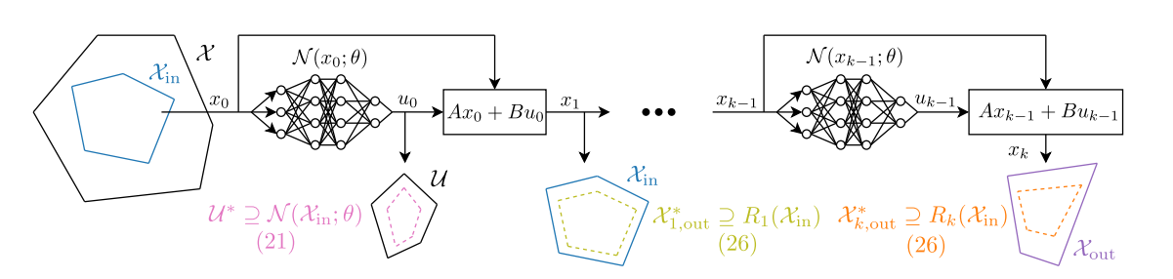
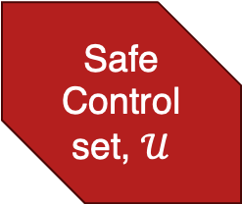
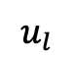
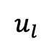






Safe Data-Driven Control
Enforce safety/stability properties in controller training, implementation
Offline training with safety constraints
Online projection to enforce safety properties.
$$Loss=f( u∈𝒰)$$
Safe Control set, $𝒰$
$$𝒫$$
$$u_{l}$$
$$x$$
$$u^{∗}$$
$$x$$
$$u_{l}$$
$$u^{∗}$$
Control
¹¹W. Shaw Cortez, J. Drgona, A. Tuor, M. Halappanavar, and D. Vrabie, “Differentiable Predictive Control with Safety Guarantees: A Control Barrier Function Approach,” in 2022 IEEE 61st Conference on Decision and Control (CDC), Dec. 2022, pp. 932–938.
Train NN-based controllers that guarantee safety constraints, stability, etc.
¹²B. Karg and S. Lucia, “Stability and feasibility of neural network-based controllers via output range analysis,” in 2020 59th IEEE Conference on Decision and Control (CDC), Dec. 2020, pp. 4947–4954.

Slide 23








Case Study: Learning Control Policies with Safety Filter
Offline training with safety constraints
Online projection to enforce safety properties.
$$Loss=f( u∈𝒰)$$
$$𝒫$$
Safe Control set, $𝒰$
$$x$$
$$u^{∗}$$
$$x$$
$$u_{l}$$
$$u_{l}$$
$$u^{∗}$$
Control
Differentiable Predictive Control
Barrier-function Safety Filter
$$u_{DPC}= π_{W^{∗}}(x)$$
$$u^{∗}(x)=argmin {\left\|u−u_{DPC}(x)\right\|}^{2}$$
$$u∈𝕌$$
$$Loss$$
subject to:
$∇h^{T}\left(f\left(x\right)+g\left(x\right)\right)u≥−α(h\left(x\right))$ $+\left|\left|∇h\right|\right|δ$
( Safe set: $𝒞=\left\{ x ∈ℝ^{n}: h\left(x\right)≥0 \right\}$ )
¹¹W. Shaw Cortez, J. Drgona, A. Tuor, M. Halappanavar, and D. Vrabie, “Differentiable Predictive Control with Safety Guarantees: A Control Barrier Function Approach,” in 2022 IEEE 61st Conference on Decision and Control (CDC), Dec. 2022, pp. 932–938.

Slide 24



Case Study: Learning Control Policies with Safety Filter
Offline training with safety constraints
Online projection to enforce safety properties.
$$Loss=f( u∈𝒰)$$
$$𝒫$$
Safe Control set, $𝒰$
$$x$$
$$u^{∗}$$
$$x$$
$$u_{l}$$
$$u_{l}$$
$$u^{∗}$$
Control
Differentiable Predictive Control
Barrier-function Safety Filter
$$u_{DPC}= π_{W^{∗}}(x)$$
$$u^{∗}(x)=argmin {\left\|u−u_{DPC}(x)\right\|}^{2}$$
$$u∈𝕌$$
$$Loss$$
Incorporate into training
subject to:
$∇h^{T}\left(f\left(x\right)+g\left(x\right)\right)u≥−α(h\left(x\right))$ $+\left|\left|∇h\right|\right|δ$
( Safe set: $𝒞=\left\{ x ∈ℝ^{n}: h\left(x\right)≥0 \right\}$ )
¹¹W. Shaw Cortez, J. Drgona, A. Tuor, M. Halappanavar, and D. Vrabie, “Differentiable Predictive Control with Safety Guarantees: A Control Barrier Function Approach,” in 2022 IEEE 61st Conference on Decision and Control (CDC), Dec. 2022, pp. 932–938.

Slide 25








Case Study: Learning Control Policies with Safety Filter
$$h\left(x,t\right)≥0$$
Dynamics
$$\dot{x} = Ax + u + w\left(t\right)$$
Barrier function:
$$h\left(x, t\right):= ε − ∥x − x_{r} \left(t\right)∥_{2}^{2}$$
Reference trajectory
Safety filter:
$$u^{∗}(x)=argmin {\left\|u−u_{DPC}(x)\right\|}^{2}$$
reference
$$u∈𝕌$$
subject to:
$∇h^{T}\left(f\left(x\right)+g\left(x\right)\right)u≥−α(h\left(x\right))$ $+\left|\left|∇h\right|\right|δ$
Barrier only ($u_{DPC}≔0)$
DPC only (trained with incorrect reference)
ZCBF+DPC (trained with incorrect reference)
ZCBF+DPC (trained with correct reference)
https://github.com/pnnl/neuromancer
¹¹W. Shaw Cortez, J. Drgona, A. Tuor, M. Halappanavar, and D. Vrabie, “Differentiable Predictive Control with Safety Guarantees: A Control Barrier Function Approach,” in 2022 IEEE 61st Conference on Decision and Control (CDC), Dec. 2022, pp. 932–938.

Slide 26
Analysis and Verification of ML Models
Colin Jones

Slide 27
Physics Informed, not Physics Enforced
Many PIML methods are “encouraging” physics, rather than “enforcing” it
Post-training verification required of key properties Lyapunov, passivity, invariance, etc
Roland Schwan, Colin Jones, EPFL

Slide 28
Verification & Analysis in Control
System Dynamics and/or Controlled Systems
Stability / dissipativity / region of attraction
Lipschitz properties
Robustness
Safety properties (constraint satisfaction)
Many people active in the area…
[Zhang et al, 2014], [Engelken et al, 2020], [Vogt et al, 2022], [Batuhan et al, 2019], [Drgona et al, 2022], [Abate et al, 2021], [Grüne et al, 2021], [Chen et al, 2021], etc
[Scaman et al, 2018], [Chakrabarty et al, 2019], [Pauli et al, 2022], [Fazlyab et al, 2022], [Erichson et al, 2021], etc
[Wang et al, 2016], [Gehr et al, 2018], [Jia et al, 2020], [Tjeng et al, 2019], etc
[Zhang et al, 2022], [Robey et al, 2020], [Karg et al, 2020], etc

Slide 29
Verification & Analysis in Control
System Dynamics and/or Controlled Systems
Stability / dissipativity / region of attraction
Lipschitz properties
Robustness
Safety properties (constraint satisfaction)
Many people active in the area…
[Zhang et al, 2014], [Engelken et al, 2020], [Vogt et al, 2022], [Batuhan et al, 2019], [Drgona et al, 2022], [Abate et al, 2021], [Grüne et al, 2021], [Chen et al, 2021], etc
[Scaman et al, 2018], [Chakrabarty et al, 2019], [Pauli et al, 2022], [Fazlyab et al, 2022], [Erichson et al, 2021], etc
Many approaches being studied
Conservative over-bounding
Lipschitz constants
GP bounds
Sampling-based methods
Function positivity / global optimziation
Mixed-integer programming
SOS / Semi-definite programming
[Wang et al, 2016], [Gehr et al, 2018], [Jia et al, 2020], [Tjeng et al, 2019], etc
[Zhang et al, 2022], [Robey et al, 2020], [Karg et al, 2020], etc

Slide 30


Standard MPC Design Process
DC-DC Buck Converter
Average dynamics over a switching period, then linearize
State Estimator + Offset-free Tracking MPC
Control frequency of 10 kHz!
STM32L476:
80 MHz clock
128 kB of RAM
1 MB of flash
25-dimensional QP with five parameters

Slide 31
Control Approximation via Deep NN
Choose parametric QP structure
→ Approximation of the dual of a standard linear MPC controller
Affine layer
QP layer
Optimal solution is differentiable
[Amos et al, 2017], [Agrawal et al, 2019]
Affine layer
Saturation layer

Slide 32






Differentiable Programming → Approximate Explicit MPC
91% complexity reduction
Training : 35min
(2021) Embedded PWM Predictive Control of DC-DC Power Converters Via Piecewise-Affine Neural Networks. IEEE OJIES. E.T. Maddalena, M.W.F. Specq, V.L. Wisniewski, C.N. Jones.

Slide 33
Verification of Approximate Controllers ↔︎ Function Positivity
Optimal control law
Approximate control law
Verification
Proving non-negativity of a function

Slide 34
Verification of Approximate Controllers ↔︎ Function Positivity
Optimal control law
Approximate control law
Verification
Proving non-negativity of a function

Slide 35
MILP-Representable Functions
MILP representable functions are dense in the family of continuous functions on a compact domain
Verification Problem
Mixed-Integer Optimization Problem
R.Schwan, C.N. Jones and D.Kuhn, Stability Verification of Neural Network Controllers using Mixed-Integer Programming, IEEE Transactions on Automatic Control. 2023, To appear

Slide 36
Some Examples
Compositions
Parametric convex QPs
Max / min
Piecewise Affine Functions

Slide 37
MILP-Representable Functions → Mixed-integer programming
Various approximate control laws can be captured
Deep neural networks
Quadratic programs
Simple saturations
etc
Verification Problem
Verification of various properties can be made
Lyapnuov function
Worst-case error
Region of attraction
etc
A number of people have developed similar formulations for polynomial control laws and SOS solvers

Slide 38

Software tool to train
approximate controllers using neural networks and/or parametric quadratic programs, and then to verify key properties.
https://github.com/PREDICT-EPFL/evanqp
Approximate parametric QP
60s
0.09s
5s
A similar tool targeted at power systems:
[Venzke, Qu, Low, Chatzivasileiadis, 2020]
Stability
Maximum error in control input
Region of attraction
✓
✓
✓

Slide 39
Verification & Analysis in Control
System Dynamics and/or Controlled Systems
Stability / dissipativity / region of attraction
Lipschitz properties
Robustness
Safety properties (constraint satisfaction)
Many people active in the area…
[Zhang et al, 2014], [Engelken et al, 2020], [Vogt et al, 2022], [Batuhan et al, 2019], [Drgona et al, 2022], [Abate et al, 2021], [Grüne et al, 2021], [Chen et al, 2021], etc
[Scaman et al, 2018], [Chakrabarty et al, 2019], [Pauli et al, 2022], [Fazlyab et al, 2022], [Erichson et al, 2021], etc
Many approaches being studied
Conservative over-bounding
Lipschitz constants
GP bounds
Sampling-based methods
Function positivity / global optimziation
Mixed-integer programming
SOS / Semi-definite programming
[Wang et al, 2016], [Gehr et al, 2018], [Jia et al, 2020], [Tjeng et al, 2019], etc
[Zhang et al, 2022], [Robey et al, 2020], [Karg et al, 2020], etc

Slide 40
Physics-Informed Digital Twins
Ankush Chakrabarty

Slide 41


Physics-Informed Digital Twins
Digital twins becoming widely available across many different domains
Defn.: Physics-informed modeling toolkits and simulation environments containing learning modules capable of adapting to operational data to maintain high prediction accuracy over product lifetime
Provides a rapid, scalable, safe, and repeatable alternative to field experiments
May not be entirely transparent
(this part of talk) Critical to design ML methods that can leverage physics-informed simulation data for:
Controller design and online performance optimization
Improving generalization via multi-source data
Data
Adaptation

Slide 42

Calibrating (Tuning) Controllers from Simulations
Control algorithms (e.g. MPC) have a few tunable parameters, say $x∈X$:
Model: unknown parameters, scenario tree
Constraints: backoff values, terminal constraints
Objective: weights in stage cost, horizon, terminal cost
Solvers: tolerance, discretization scheme
References: set-points, path trajectories
Must define performance index $f\left(x\right)$ over closed-loop simulation: $f$ may be nasty (= expensive, no gradients)
Auto-tuning = global optimization problem, $\min_{x∈X}{f\left(x\right)}$
Bayesian Optimization (BO) is an effective auto-tuning strategy when working directly with simulation data

Slide 43


Bayesian Optimization (BO)
BO does not require any knowledge of structure and/or gradient of $f$ and can tolerate noisy observations
Flexible
BO avoids getting “stuck” in local solutions (global optimization)
Can “teleport” throughout design space
BO requires few evaluations and concurrently learns a surrogate model of the CL performance
Check out the paper for a real-world use-case of BO-based safe controller tuning in vapor compression systems!

Slide 44




BO is Extremely Flexible & Can Exploit Structure!
Input-dependent noise
Robust optimization
Multi-objective & constraints
[Kersting et al., 2007; Lazaro-Gredilla et al., 2011]
[Paulson et al., 2021; Kudva et al. 2022]
[Makrygiorgos et al., 2022; Lu et al., 2022, Xu et al. 2022]
Notes:
LATEXIT:
f(x) = g(x) + \varepsilon(x)
f(x) = \max_{w \in \mathcal{W}}~g(x, w)
f^{(1)}(x), \ldots, f^{(M)}(x)
f(x) ~~\text{s.t.}~~c(x) \leq 0

Slide 45



Simulation Environments Enable Generation of Multi-Source Data
PI digital twins comprise parameterized components that can be modified to generate useful data from multiple source systems similar to the target system
This multi-source dataset:
Reduces data requirements from one system by harnessing data from similar systems
Specific ML frameworks are suited to learning from multi-source data:
Meta-learning and transfer-learning
Simulator
Sources
Targets

Slide 46






Meta-Learning
Classical meta-learners rely on 2 training loops:
A feature re-use loop for learning features useful over all source data i.e., task-independent
A rapid adaptation loop for network to perform well on single task i.e., task-specific
The adaptation is “baked in” to the training procedure: this will be exploited at inference
Rapid Adaptation
[Finn et al., 2017; Raghu et al., 2019]
gradient step
$$∇ℒ_{1}$$
Source: bair.berkeley.edu
feature re-use
rapid adaptation
$$∇ℒ(θ)$$
data
$$∇ℒ_{2}$$
$$∇ℒ_{3}$$
gradient step
Feature Re-use

Slide 47

Transfer-Learning
Transfer learning involves two separate single-loop training procedures
1st training phase: learn task-independent representations
2nd training phase: pre-trained network modified and fine-tuned for the target task
Unlike meta-learning:
Adaptation is made problem-specific by 2nd phase, not baked in
2nd-phase training not necessarily few-shot (offline)
Same network may not be used at training v. inference

Slide 48



Snapshot of Multi-Source Learning for Control
Meta-learning for model identification:
Meta-GP for MPC
Meta-learned state-space models
Meta-learning for controller and parameter tuning:
Meta-learned BayesOpt
Meta-learned adaptive control
Transfer-learning for modeling and control
Multi-fidelity auto-tuning
[Arcari et al., 2022]
[Chakrabarty et al., 2023]
[Chakrabarty, 2022; Zhan et al., 2022]
[Richards et al., 2021; Richards et al., 2022]
[Chen et al., 2020; Xu et al., 2020]
[Sorourifar et al., 2021]
Notes:
LATEXIT:
f(x) = g(x) + \varepsilon(x)
f(x) = \max_{w \in \mathcal{W}}~g(x, w)
f^{(1)}(x), \ldots, f^{(M)}(x)
f(x) ~~\text{s.t.}~~c(x) \leq 0

Slide 49
Opportunities for PIML4C
Modeling of human(-in-the-control-loop) behaviors
PIML for scalable, interaction-aware controllers for multi-component systems
Interpretable and verifiable explicit MPC policies via physics injection during learning
Providing safety and performance guarantees – new theoretical tools
Automated adaptation via simulation (closing sim2real gap)
Integration of multimodal signals (speech, image/video) into control loops
Notes:
LATEXIT:
f(x) = g(x) + \varepsilon(x)
f(x) = \max_{w \in \mathcal{W}}~g(x, w)
f^{(1)}(x), \ldots, f^{(M)}(x)
f(x) ~~\text{s.t.}~~c(x) \leq 0

Slide 50
Challenges for PIML4C
Quantification of ‘minimal’ = ‘useful’ and ‘useful’ data requirements
Quantification of uncertainty and modeling errors
Quantification of similarity in multi-source learning
Formal guarantees of safety/stability for closed loop PIML based controllers
Scaling up of verification methods
Notes:
LATEXIT:
f(x) = g(x) + \varepsilon(x)
f(x) = \max_{w \in \mathcal{W}}~g(x, w)
f^{(1)}(x), \ldots, f^{(M)}(x)
f(x) ~~\text{s.t.}~~c(x) \leq 0

Slide 51
Summary & Conclusions
Classically, ML methods do not integrate known physical constraints
PIML methods have emerged to systematically combine data-driven ML with physics-based modeling
PIML methods offer new and exciting opportunities for human-in-the-loop, multi-scale and multi-physics systems
Open challenges remain: an exciting time to solve problems in PIML!
Notes:
LATEXIT:
f(x) = g(x) + \varepsilon(x)
f(x) = \max_{w \in \mathcal{W}}~g(x, w)
f^{(1)}(x), \ldots, f^{(M)}(x)
f(x) ~~\text{s.t.}~~c(x) \leq 0

